Slide 1
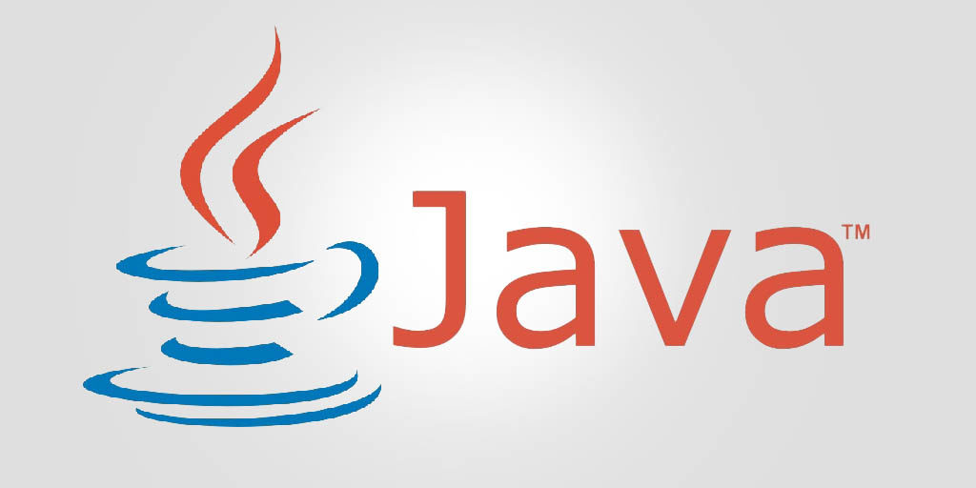
CSE110 Principles of Programming Lecture 5: Methods
Professor Shaker El-Sappagh
Shaker.elsappagh@gu.edu.eg
Fall 2023

Slide 2
Outline
Why Methods
What are methods
Method declaration
Method overriding

Slide 3
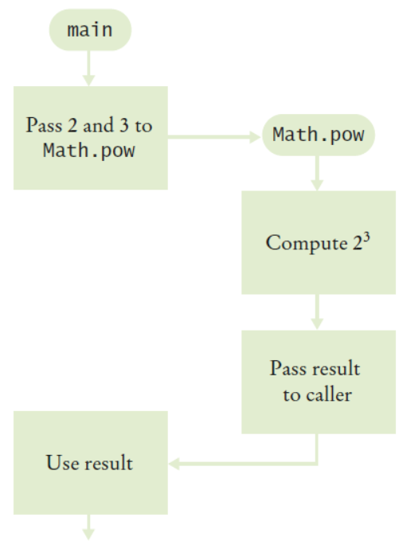
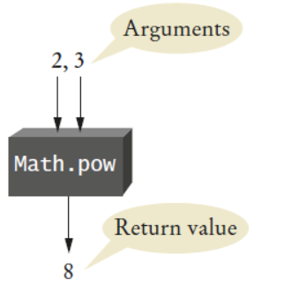
Methods as Black Boxes
A method is a sequence of instructions with a name.
You have already encountered several methods.
Math.pow method contains instructions to compute a power xy.
The main method.
You call a method in order to execute its instructions.
public static void main(String[] args)
{
double result = Math.pow(2, 3);
. . .
}
The instructions of the Math.pow method execute and compute the result.
The Math.pow method returns its result back to main, and the main method resumes execution.

Slide 4
Why Write Methods?
Methods are commonly used to break a problem down into small manageable pieces. This is called divide and conquer.
Methods simplify programs. If a specific task is performed in several places in the program, a method can be written once to perform that task, and then be executed anytime it is needed. This is known as code reuse.

Slide 5
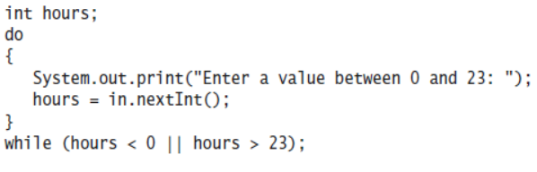
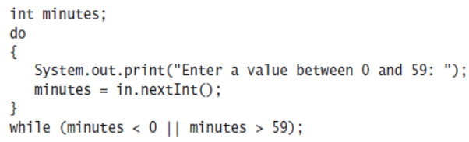
Why Write Methods?
When you write nearly identical code or pseudocode multiple times, either in the same program or in separate programs, consider introducing a method. Here is a typical example of code replication:

Slide 6
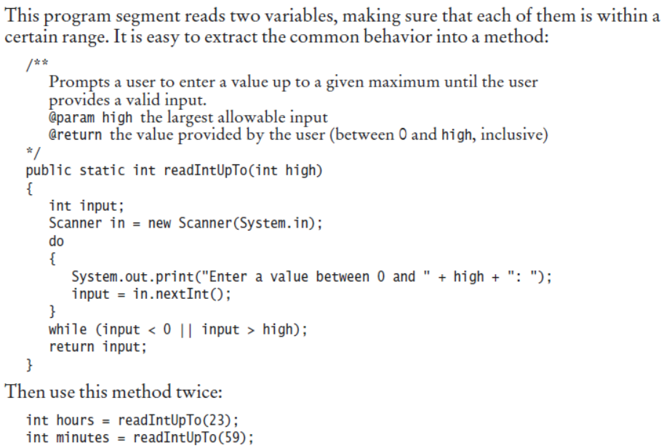
Why Write Methods?

Slide 7
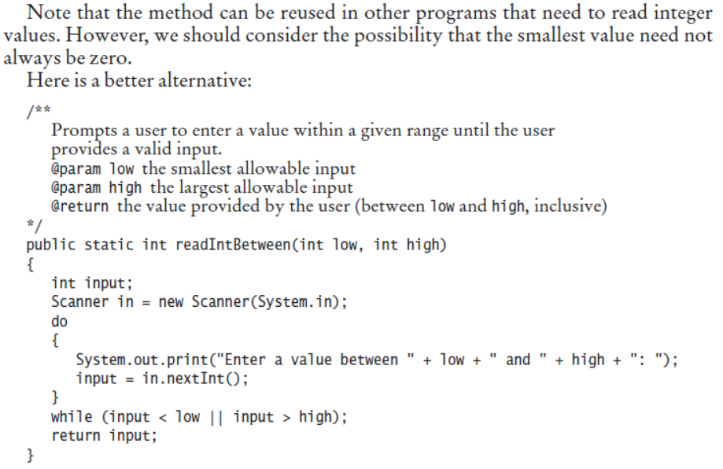
Why Write Methods?

Slide 8
User-defined Methods
WHAT?
A user-defined method is a small program (set of statements) that is written once in the program, but used as much as needed.
Pre-defined methods are provided by Java.
User-defined methods are designed by the programmer.
A programmer codes a method when it is not readily provided by Java.
The programmer may write one or more methods in the program.
User-defined methods are placed after the end of the main method.
Methods are executed only when they are called.

Slide 9
User-defined Methods
LAYOUT
The layout of a program with methods is as follows:
1
2
3
4
5
6
7
8
9
10
11
12
13
14
15
16
17
18
19
20
21
22
23
24
import java.util.*;
public class layout
{
public static void main(String[] args)
{
…
…
…
} //end of main
public static void method1()
{
…
…
} //end of method1
public static void method2()
{
…
…
} //end of method2
} //end of class

Slide 10
User-defined Methods
WHY?
Programmers may need methods for one or more of the following reasons:
Modularity: Breaking up the problem into sub-problems.
Top-Down Design Approach: When attempting to solve a problem at one level, new sub-problems arise at a lower level.
Code Sharing: In big projects, the coding is assigned to many different people. Every programmer writes one or methods, then these are assembled in a single program. This is impossible to achieve without the concept of methods.
Create packages: In the same way, there are java.util.*, java.lang.*, you can create your own package using classes and methods.

Slide 11
User-defined Methods
EXAMPLE
1
2
3
4
5
6
7
8
9
10
11
12
13
14
15
16
17
import java.util.*;
public class layout
{
public static void main(String[] args)
{
int x, y;
…
if (y == 0)
errorMessage(); //method calling (using)
} //end of main
//method definition: This method prints an error message
public static void errorMessage()
{
System.out.println (“There is something wrong…!!”);
} //end of errorMessage
} //end of class
Method header

Slide 12
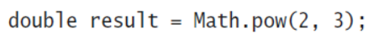
Methods as Black Boxes
Method definition and defining method parameters.
Method call and providing arguments.
After calling, the method is executed and returns one value.
Methods can receive multiple arguments, but they return only one value.
It is possible to have methods with no arguments. An example is the Math.random.
By reusing a method, you don’t need to know how the method is implemented.
You can think of Math.pow as a black box
Reusability and the Java class library.
When you design your own methods, you will want to make them appear as black boxes to other programmers. Those programmers want to use your methods without knowing what goes on inside.
Even if you are the only person working on a program, making each method into a black box

Slide 13
Predefined methods and Java class library
External file: predefined methods

Slide 14
Method declaration
Specifies all the information needed to call the method.
Two of the parts—the method name and parameter list—are called the method signature. The method signature provides instructions for how callers can reference this method.
The method signature does not include the return type and access modifiers, which control where the method can be referenced.
Header
public static void displayMesssage()
{
System.out.println("Hello");
}
Body

Slide 15
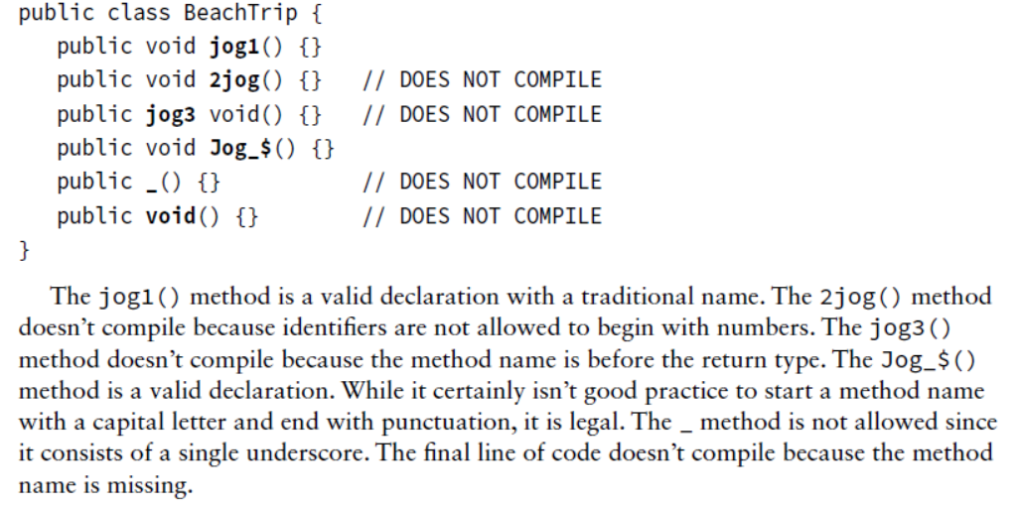
Method Name
Method names follow the same rules we practiced with variable names

Slide 16
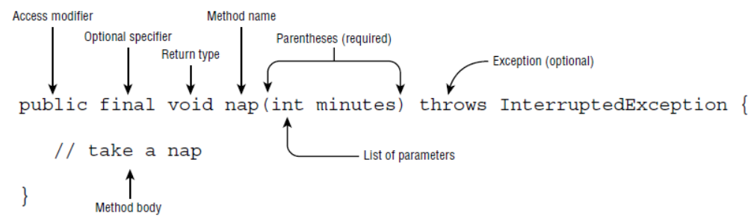
Parts of a Method Header
Method Modifiers
Return Type
Method Name
Parentheses
public static void displayMessage ()
{
System.out.println("Hello");
}

Slide 17
Parts of a Method Header
Method modifiers
public—method is publicly available to code outside the class
static—method belongs to a class, not a specific object.
Return type—void or the data type from a value-returning method
Method name—name that is descriptive of what the method does
Parentheses—contain nothing or a list of one or more variable declarations if the method is capable of receiving arguments.

Slide 18
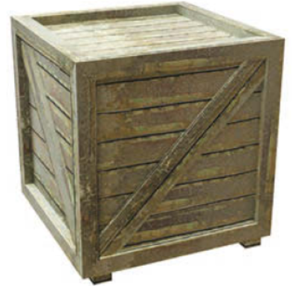
Implementing Methods
The cubeVolume method uses a given side length to compute the volume of a cube.
When writing this method, you need to:
Pick a name for the method (cubeVolume).
Declare a variable for each argument (double sideLength). These variables are called the parameter variables.
Specify the type of the return value (double).
Add the public static modifiers. We will discuss the meanings of these modifiers
Put all this information together to form the first line of the method’s declaration:
public static double cubeVolume(double sideLength)
This line is called the header of the method. Next, specify the body of the method. The body contains the variable declarations and statements that are executed when the method is called.

Slide 19
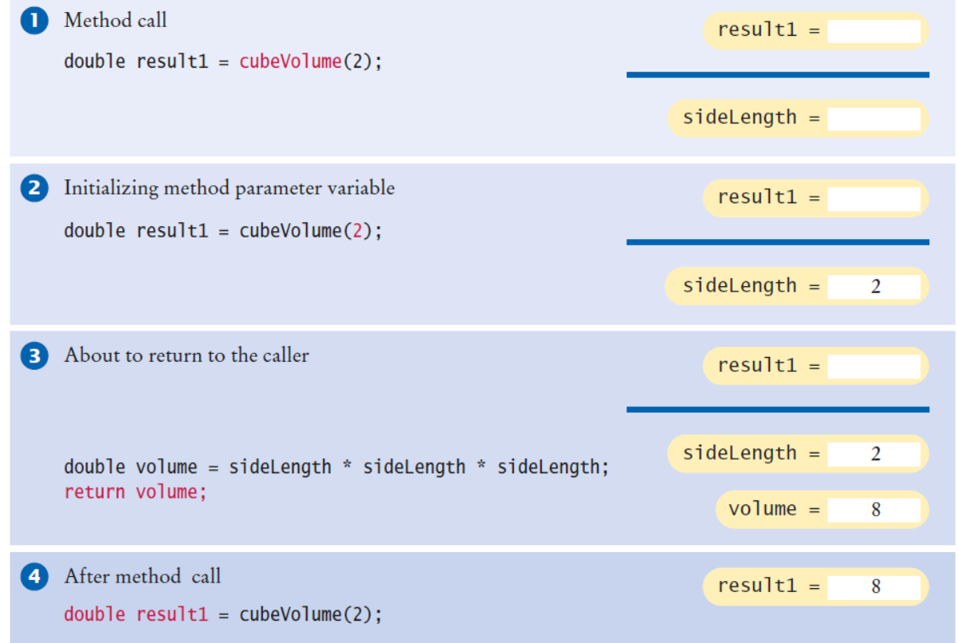
Parameter Passing

Slide 20
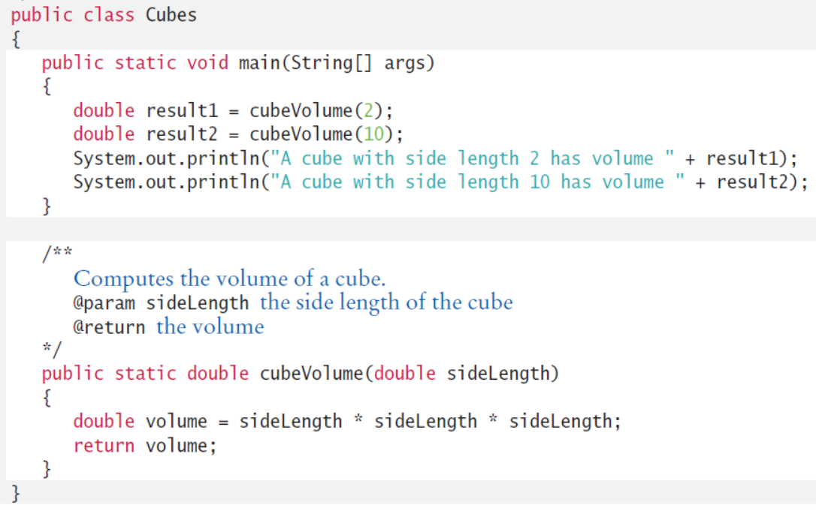
Implementing Methods
The body of a method is enclosed in braces.

Slide 21
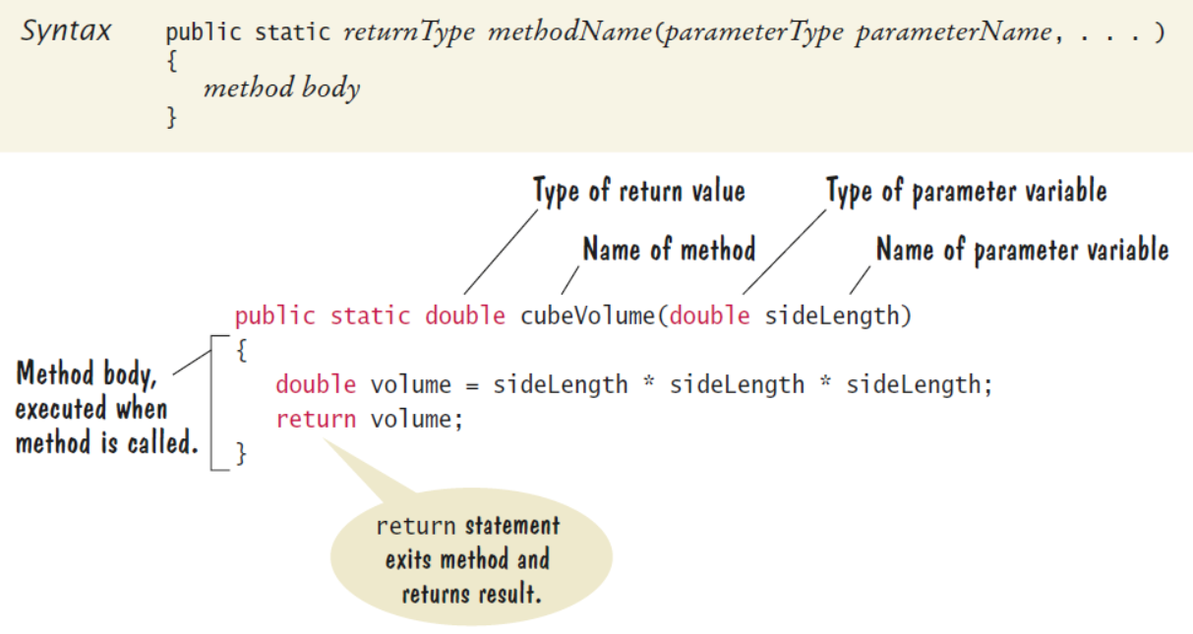
Implementing Methods

Slide 22
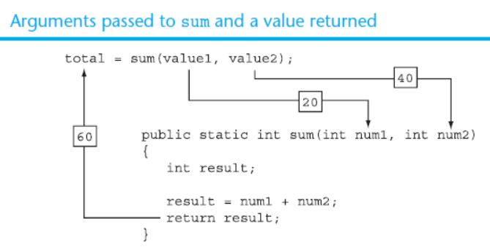
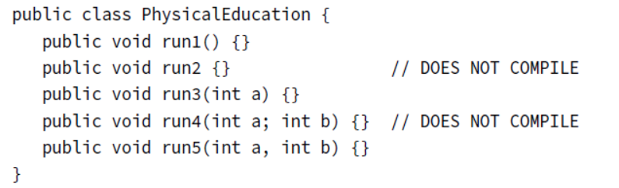
Argument Passing
Java is a “pass-by-value” language. This means that a copy of the variable is made and the method receives that copy.
When a method is called, variables are created for receiving the method’s arguments. These variables are called parameter variables.
The values that are supplied to the method when it is called are the arguments of the call.
Each parameter variable is initialized with the corresponding argument.
If you do have multiple parameters, you separate them with a comma.

Slide 23
Passing Arguments to a Method
Values that are sent into a method are called arguments.
System.out.println("Hello");
number = Integer.parseInt(str);
The data type of an argument in a method call must correspond to the variable declaration in the parentheses of the method declaration. The parameter is the variable that holds the value being passed into a method.
By using parameter variables in your method declarations, you can design your own methods that accept data this way.

Slide 24
Passing 5 to the displayValue Method
displayValue(5);
public static void displayValue(int num)
{
System.out.println("The value is " + num);
}
The argument 5 is copied into the parameter variable num.
The method will display The value is 5

Slide 25
Argument and Parameter Data Type Compatibility
When you pass an argument to a method, be sure that the argument’s data type is compatible with the parameter variable’s data type.
Java will automatically perform widening conversions, but narrowing conversions will cause a compiler error.
double d = 1.0;
displayValue(d);
Error! Can’t convert double to int

Slide 26
Passing Multiple Arguments
The argument 5 is copied into the num1 parameter.
The argument 10 is copied into the num2 parameter.
showSum(5, 10);
public static void showSum(double num1, double num2)
{
double sum; //to hold the sum
sum = num1 + num2;
System.out.println("The sum is " + sum);
}
NOTE: Order matters!

Slide 27
Arguments are Passed by Value
In Java, all arguments of the primitive data types are passed by value, which means that only a copy of an argument’s value is passed into a parameter variable.
A method’s parameter variables are separate and distinct from the arguments that are listed inside the parentheses of a method call.
If a parameter variable is changed inside a method, it has no affect on the original argument.

Slide 28
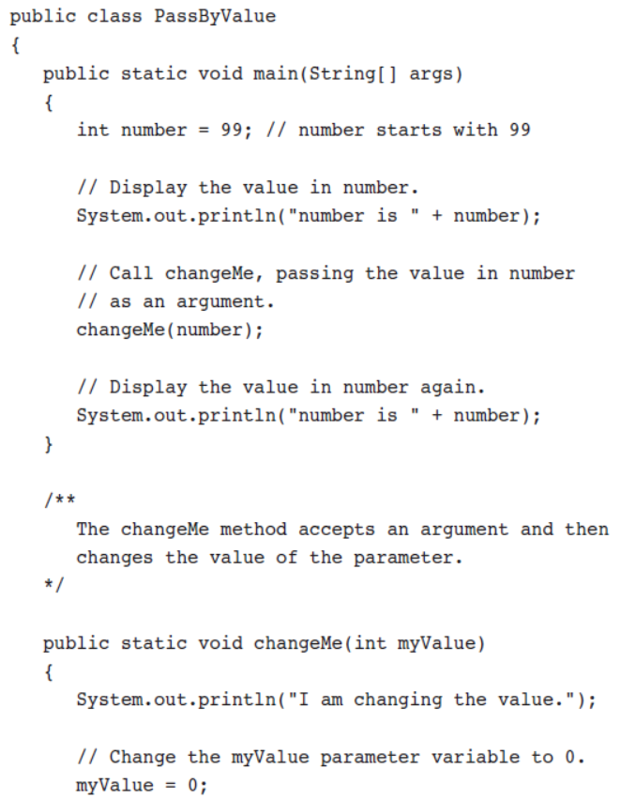
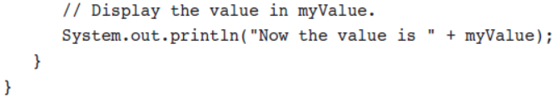
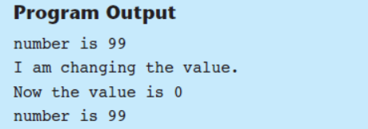

Slide 29
Passing Object References to a Method
Recall that a class type variable does not hold the actual data item that is associated with it, but holds the memory address of the object. A variable associated with an object is called a reference variable.
When an object such as a String is passed as an argument, it is actually a reference to the object that is passed.

Slide 30
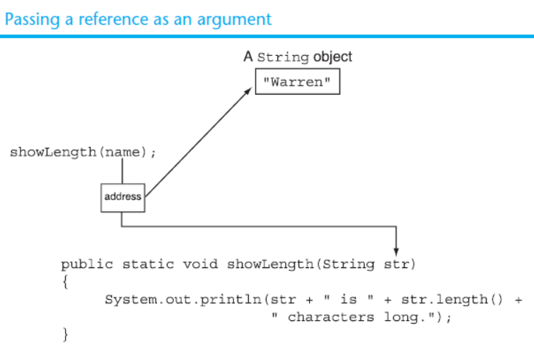
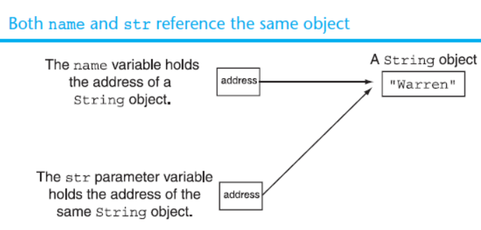
Passing a Reference as an Argument

Slide 31
Strings are Immutable Objects
The name variable holds the address of a String object
address
“Warren”
The str variable holds the address of a different String object
address
“Joe”
Strings are immutable objects, which means that they cannot be changed. When the line
str = "Joe";
is executed, it cannot change an immutable object, so creates a new object.

Slide 32
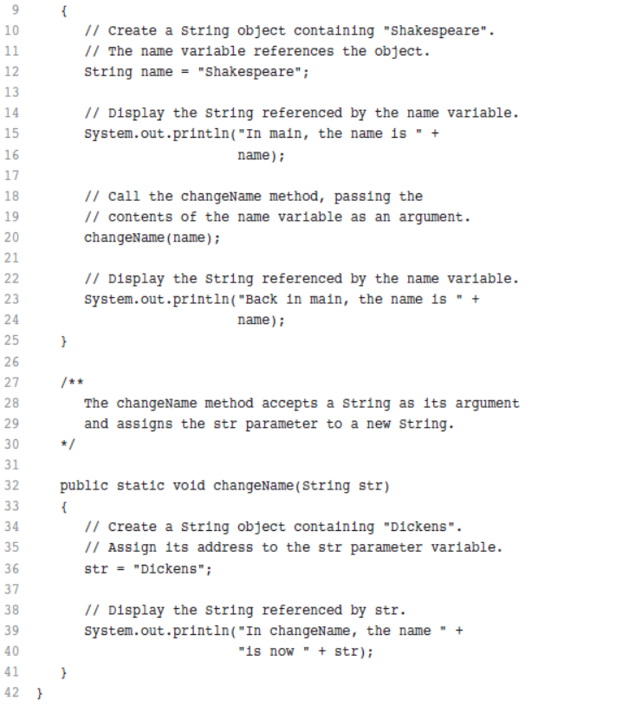
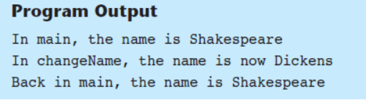
Passing a Reference as an Argument

Slide 33
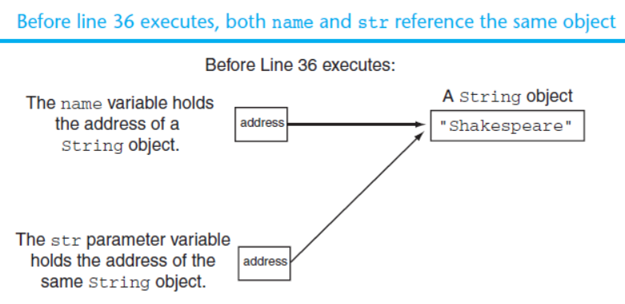
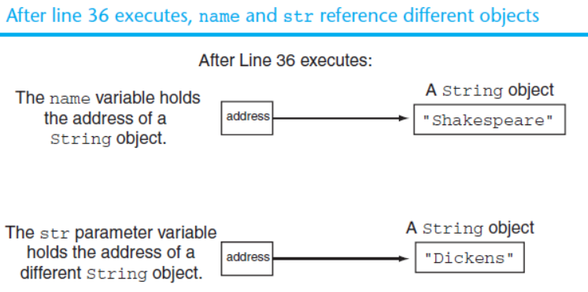
Passing a Reference as an Argument

Slide 34
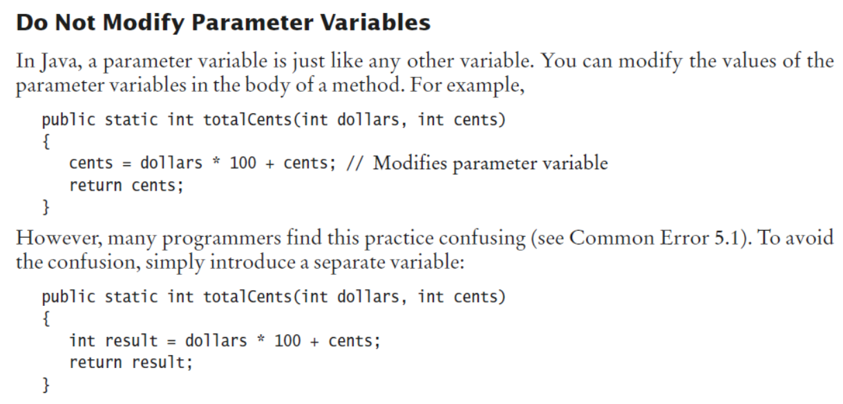
Parameter Passing

Slide 35
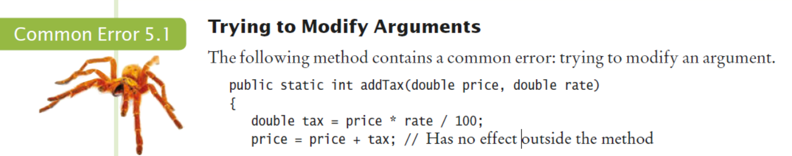
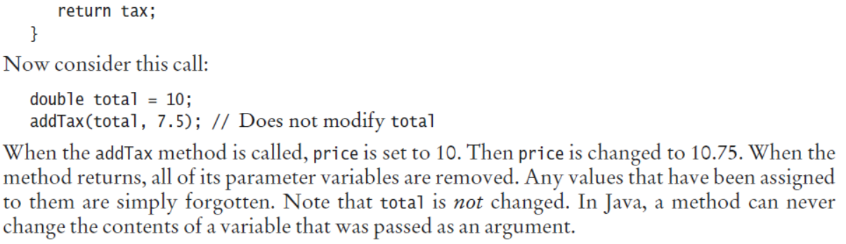
Parameter Passing
.

Slide 36
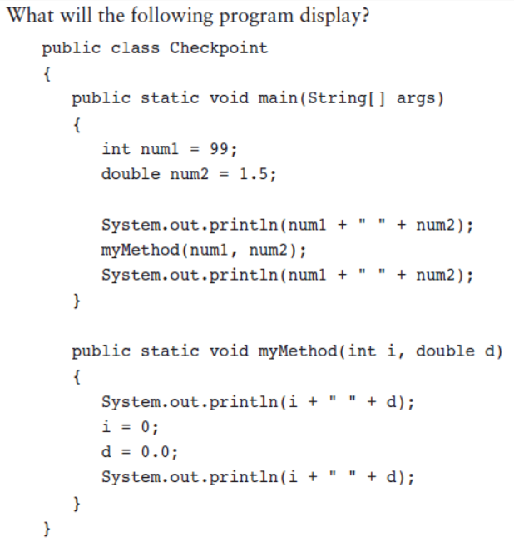
Exercises

Slide 37
Parameter Passing
L6 - User-defined Methods - Passing Parameters

Slide 38
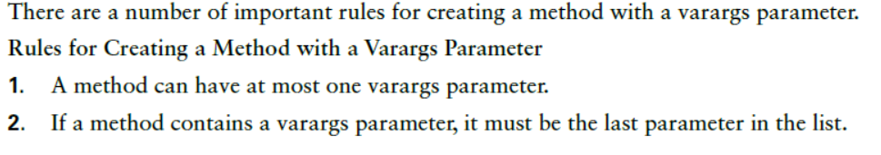
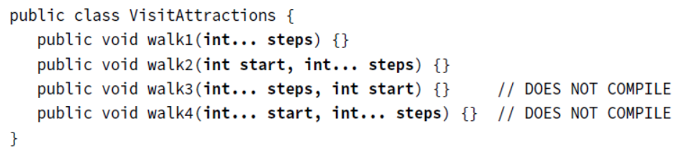
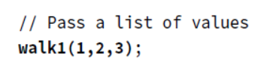
Working with Varargs
A method may use a varargs parameter (variable argument) as if it is an array. Creating a method with a varargs parameter is a bit more complicated.

Slide 39
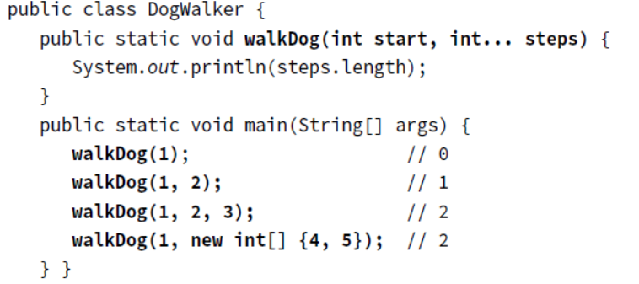
Working with Varargs

Slide 40
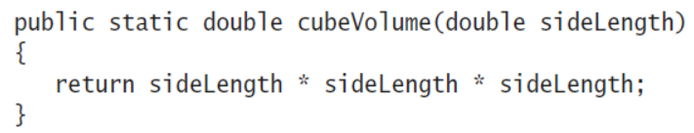
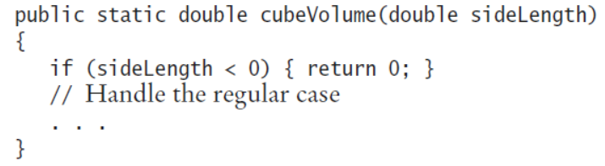
Return Values
The return statement terminates a method call and yields the method result.
the return statement can return variable, a value of any expression, or scaler value.
Instead of saving the return value in a variable and returning the variable, it is often possible to eliminate the variable and return a more complex expression:
When the return statement is processed, the method exits immediately.

Slide 41
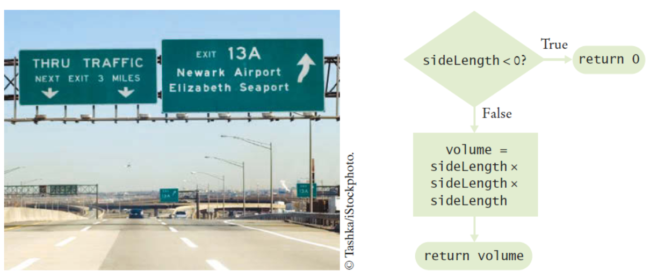
Return Values
A return Statement Exits a Method Immediately

Slide 42
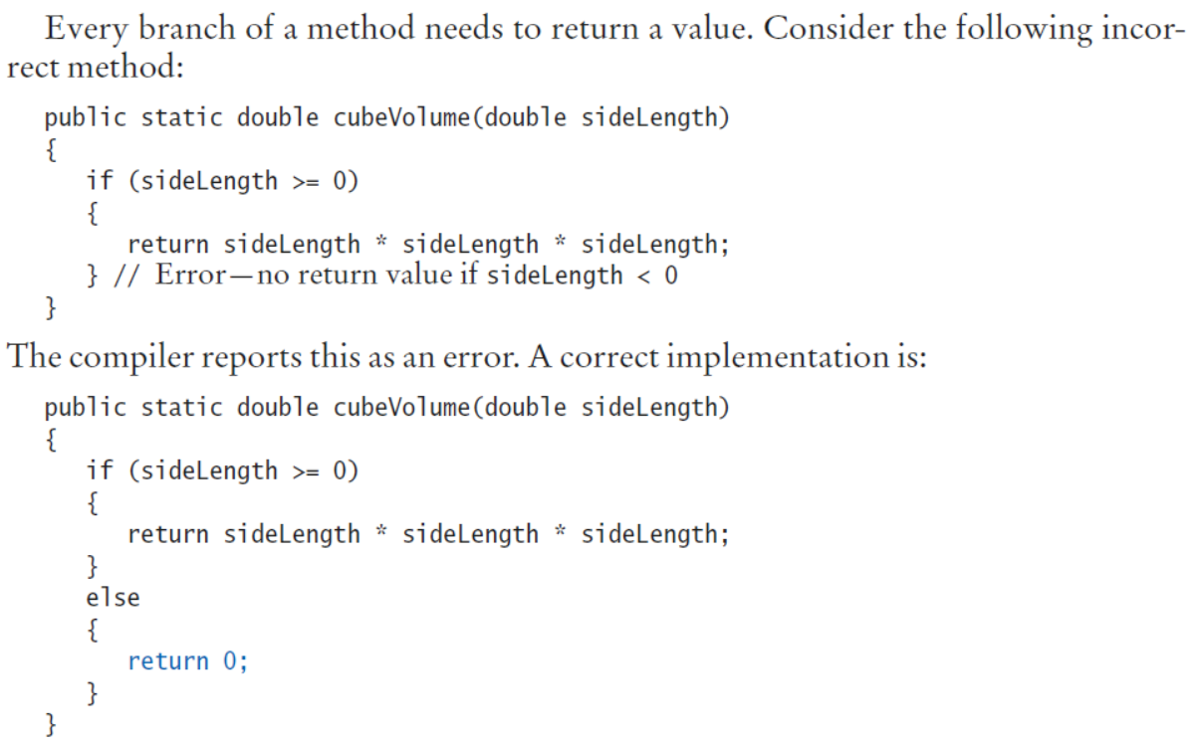

Slide 43
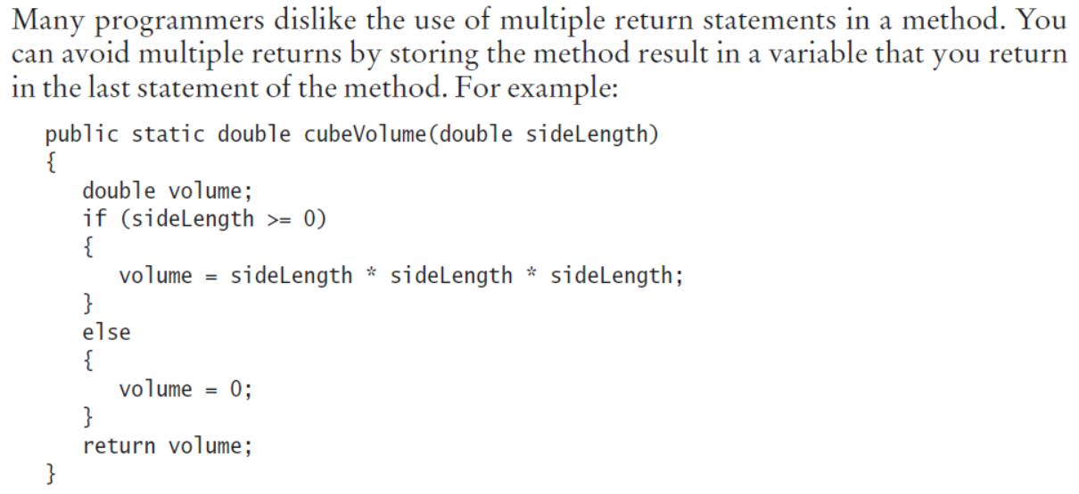
Return Values
.

Slide 44
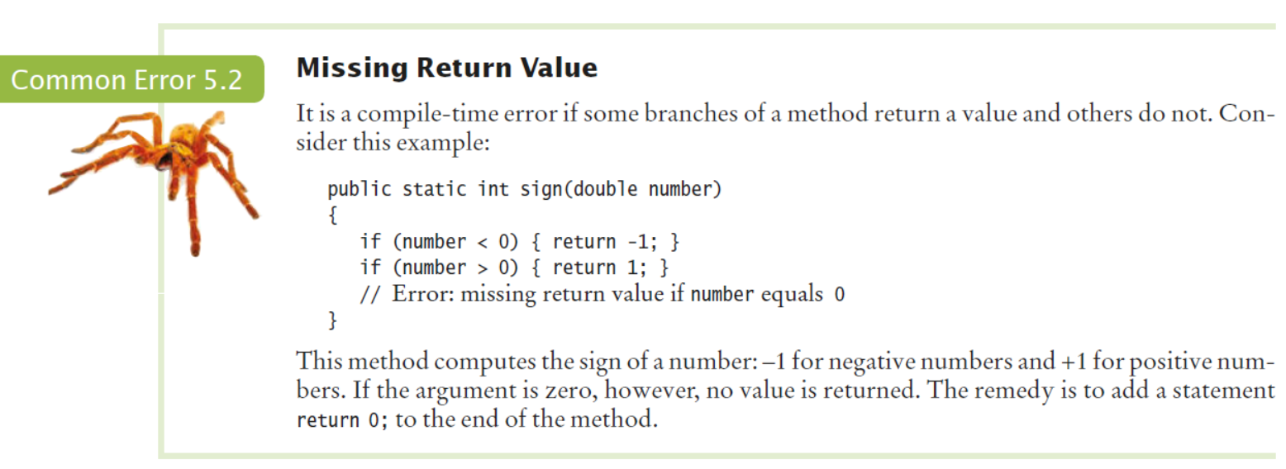
Return Values

Slide 45
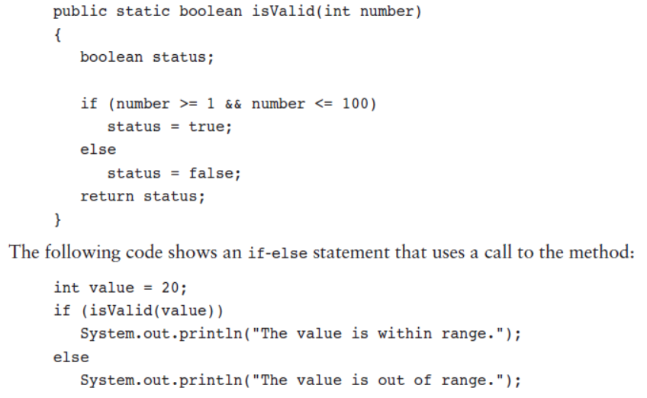
Returning a boolean Value

Slide 46
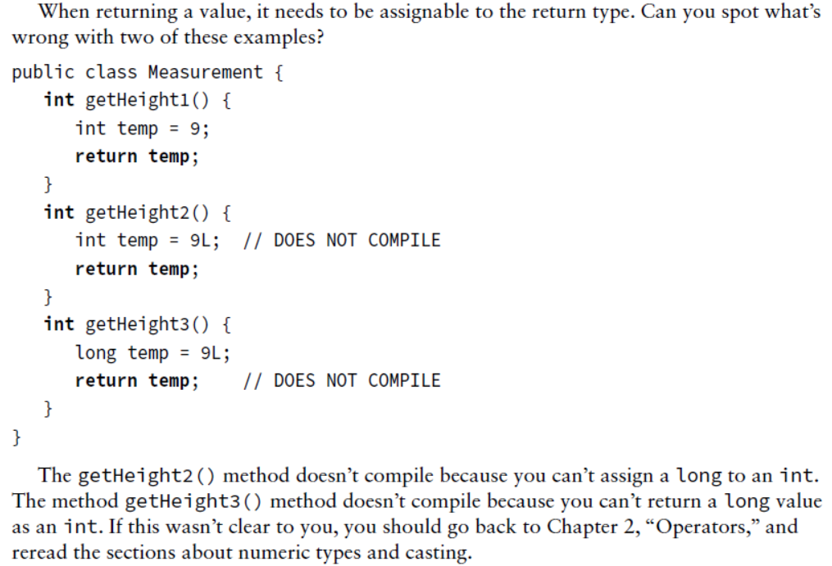
Return Values

Slide 47
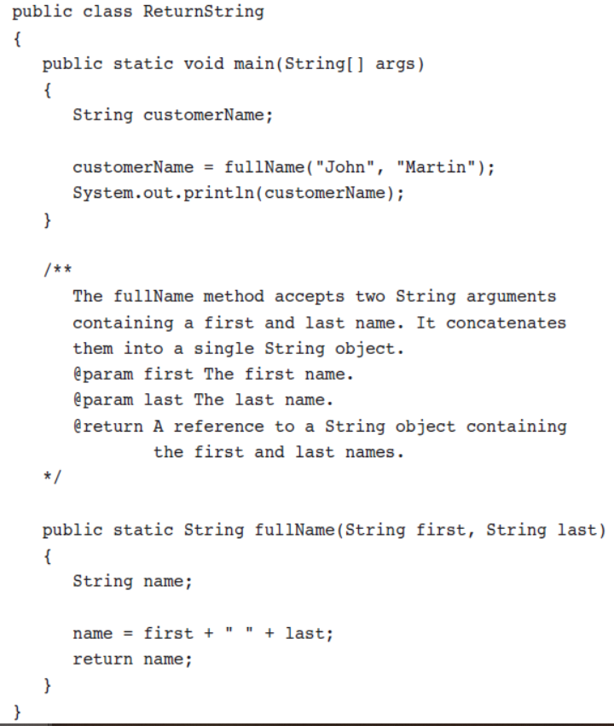
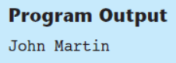
Returning a Reference to an object

Slide 48
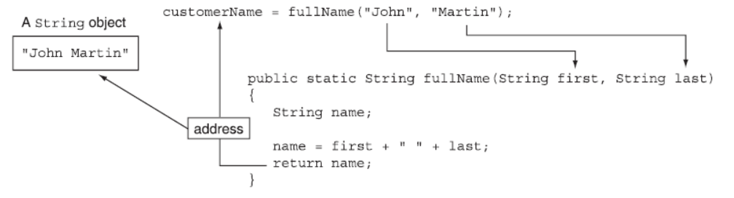
Returning a Reference to an object

Slide 49
Returning Value
L6 - User-defined methods - value-returning

Slide 50
void Methods and Value-Returning Methods
Sometimes, you need to carry out a sequence of instructions that does not yield a value.
A void method is one that simply performs a task and then terminates.
System.out.println("Hi!");
A value-returning method not only performs a task, but also sends a value back to the code that called it.
int number = Integer.parseInt("700");

Slide 51
Defining a void Method
To create a method, you must write a definition, which consists of a header and a body.
The method header, which appears at the beginning of a method definition, lists several important things about the method, including the method’s name.
The method body is a collection of statements that are performed when the method is executed.

Slide 52
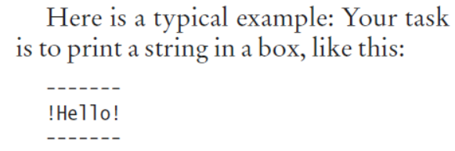
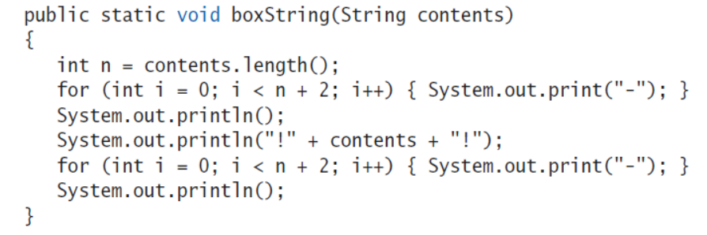
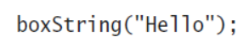
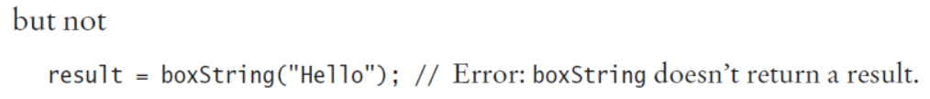
Methods Without Return Values
If that instruction sequence occurs multiple times, you will want to package it into a method.

Slide 53
Defining a void Method
L6 - User-defined methods - void

Slide 54
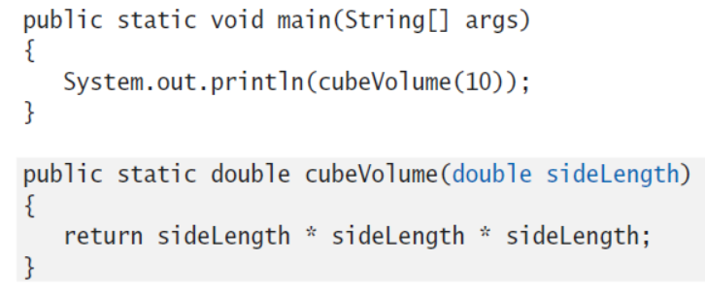
Variable Scope
The scope of a variable is the part of the program in which you can access it.
For example, the scope of a method’s parameter variable is the entire method.

Slide 55
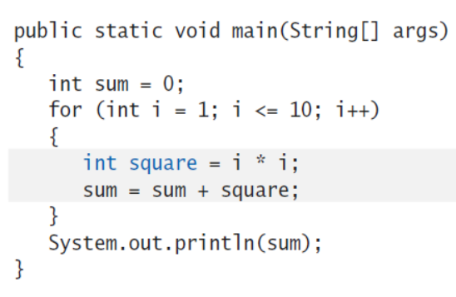
Variable Scope
A variable that is defined within a method is called a local variable.
When a local variable is declared in a block, its scope ranges from its declaration until the end of the block.

Slide 56

Variable Scope

Slide 57

Variable Scope

Slide 58

Variable Scope

Slide 59

Variable Scope

Slide 60



Variable Scope

Slide 61
Identifier Scope
L6 - User-defined Methods - Scope

Slide 62
Overloading Methods
Method overloading occurs when methods in the same class have the same name but different method signatures, which means they use different parameter lists.
We’ve been showing how to call overloaded methods for a while. System.out.println().
Overloading also allows different numbers of parameters.
L6 - User-defined Methods - Overloading

Slide 63
Default parameters
Java does not support the concept of default parameter however, you can achieve this using
1. Method overloading
Using method overloading if you define method with no arguments along with parametrized methods. Then you can call a method with zero arguments.
2. Variable arguments
In Java methods parameters accept arguments with three dots. These are known as variable arguments. Once you use variable arguments as a parameter method, while calling you can pass as many number of arguments to this method (variable number of arguments) or, you can simply call this method without passing any arguments.

Slide 64
Recursive Methods
This topic will be taken in a separate lecture.

Slide 65
Thank you

